Slide 1
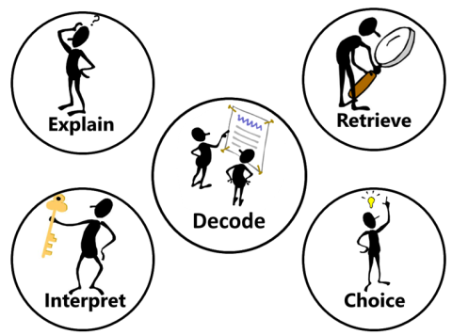
READING WITH (D)ERIC

Slide 2
When teaching reading, we use (D)ERIC.
The D for “Decoding” is a major focus of reading in EYFS and KS1 – teaching the children how to break down and read the actual words in the text. Phonics is a vital part of this aspect of learning.

Slide 3
When the children are secure in their ability to decode, the emphasis moves to “Comprehension” – understanding the meaning of what they have read and being able to answer questions on the text.
Those questions focus on four skills:
Explain
Retrieve
Interpret
Choice (of the author)

Slide 4
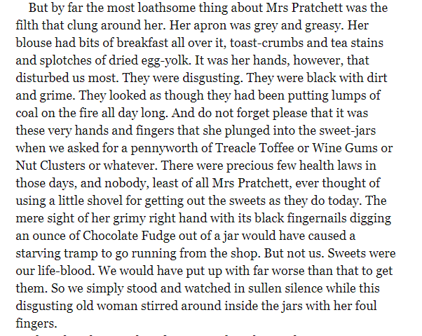
RETRIEVAL is the first, and most straightforward, of the skills we teach. It involves finding an answer directly from the text.
For example:
Q: What was the most loathsome thing about Mrs Pratchett?
A: The filth that clung around her.
From “Boy” by Roald Dahl

Slide 5
EXPLAIN asks the children to do just that:
Q: Why was it that the children were most disturbed by Mrs Pratchett’s hands?
A: Because her hands were disgusting –”black with dirt and grime” – and she used them to touch the sweets that the children bought, so they would probably be covered in dirt and germs as well.

Slide 6
INTERPRET asks the children to use inference – or to give their opinion:
Q: Why do you think Mrs Pratchett was able to behave in the way that she did?
A: I think that she could be like this because in those days there was not so much emphasis on things being germ-free, so she could get away with being dirty and grimy. Also, hers was the only local sweet shop, so the children had no choice – they had to shop there.

Slide 7
CHOICE, means the author’s choice or intention.
Q: Thinking about what you know about Roald Dahl, which of his books/characters might have been based on Mrs Pratchett?
A: I think that Dahl might have based either “The Witches” or “Mrs Twit” on Mrs Pratchett. He has exaggerated his description of her – making her really disgusting, just like the characters in his books.

Slide 8
