Slide 1
Monday 29th January 2024
Mrs Begum and Miss Stone

Slide 2
In May this year, Year 2 children will be completing the End of Key Stage 1 Standard Assessment Tests (SATs).
From this academic year onwards, these assessments are no longer a statutory requirement, however schools can opt to still undertake these assessments and at we have opted to do so.
The aim of undertaking these optional assessments is to support with the measurement of pupil achievement and to help identify where our pupils need additional support as they transition into key stage 2 (KS2).
The assessments will also be used to support our teacher assessment judgements for English and Maths at the end of the academic year.

Slide 4
First of all, do not worry. The testing is organised in a way that will feel as informal as possible for the children.
To them it will feel like one of the many other assessments we do throughout the year.
Tests are completed in classrooms, with all displays and resources covered up.
The tests will be spread out over a couple of weeks with only one test being done each day.

Slide 5
working towards,
We will take into account the child’s work throughout the year as well as their SATs score.
The teachers mark their tests themselves so will be familiar with handwriting etc.

Slide 8
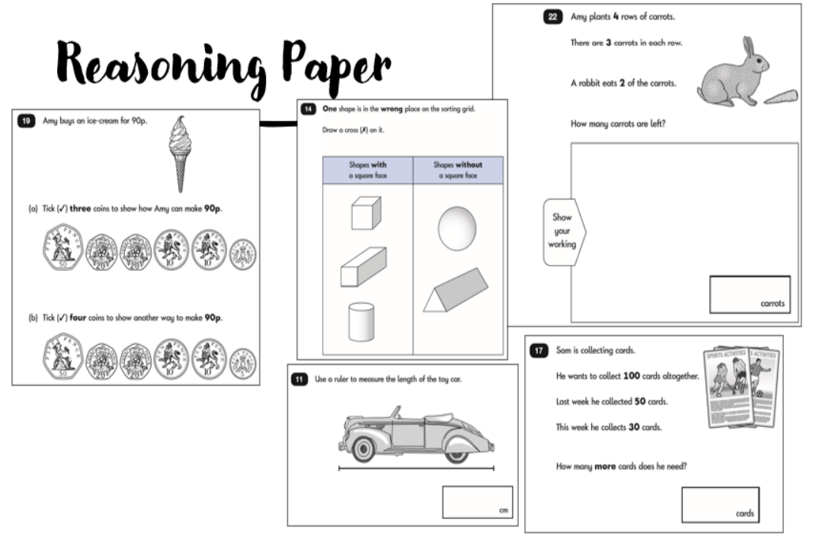

Slide 9
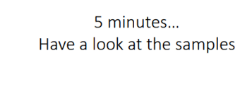
Reading Comprehension

Slide 10
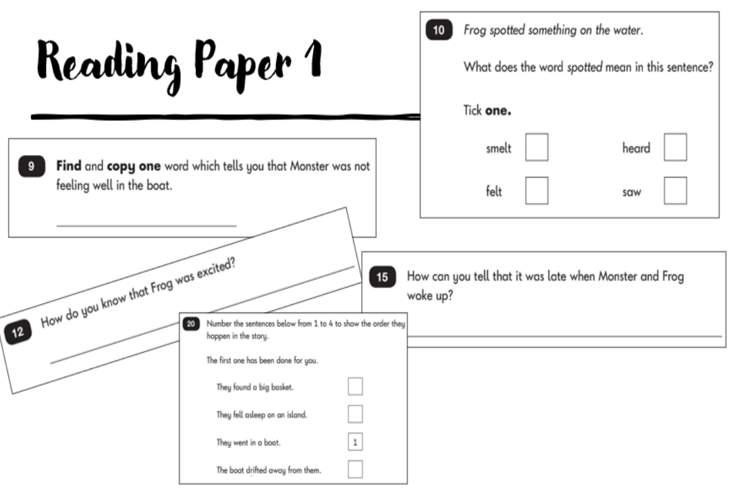

Slide 11
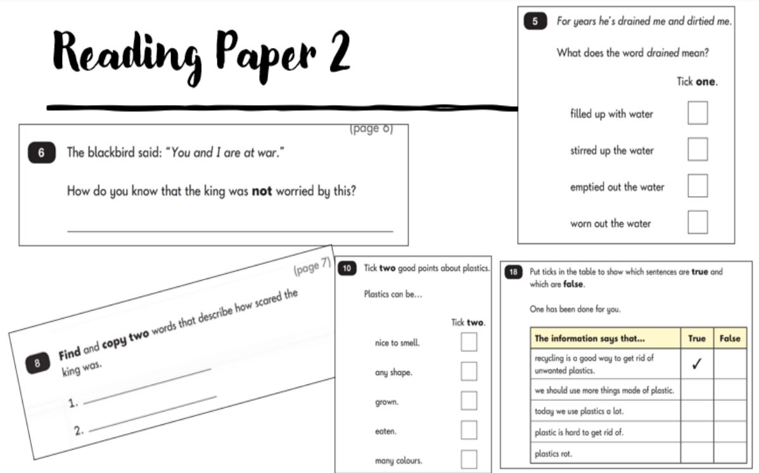

Slide 12
SPaG

Slide 13
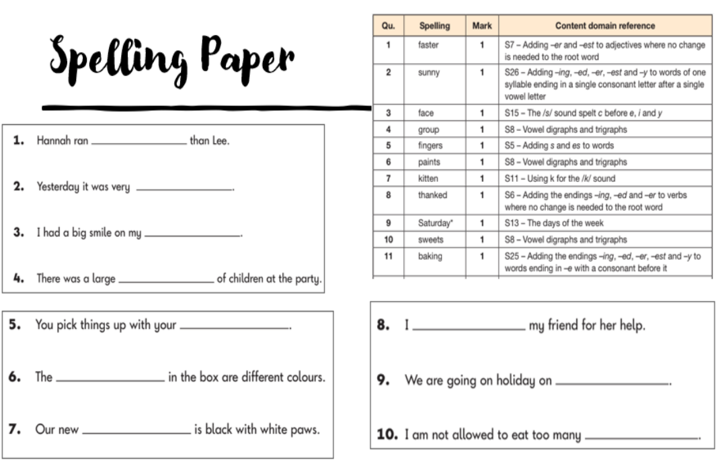

Slide 14
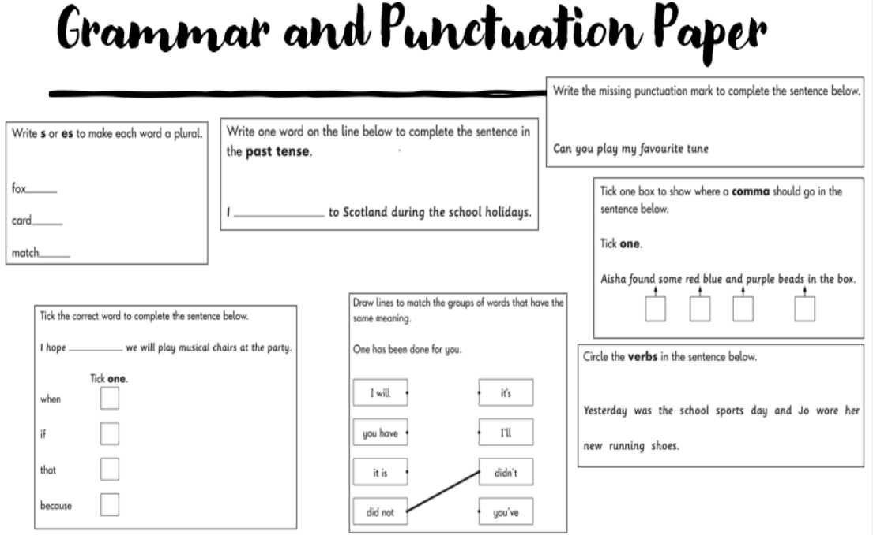

Slide 15
Writing
The children will also be teacher judged for their writing skills – emerging, expected, greater depth.
To help us make our judgement, in May the children will do a number of unaided pieces of writing to help their teacher make a judgement on their level.
These will be in genres they have written before e.g. instructions, reports and stories that they know really well. The writing will be well planned and taught before-hand so the children are confident with writing independently.

Slide 16
How can you help at home now?
Apps/Websites
TopMarks
Hit the Button
BBC Bitesize
White Rose 1 minute Maths
In the Car
Count in 2s, 5s, 10s and 3s.
Find 10 more / 10 less within 100.
At home
READING – Every night. This will help in every subject.
Homework – always based on what we have previously learnt.
Spellings – based on the Year 2 Common Exception Words.
Charades or hangman.
… more reading!!

Slide 17
Any questions?

